Slide 1
Week 4
Single Source Shortest Paths
All Pairs Shortest Path Problem

Slide 2
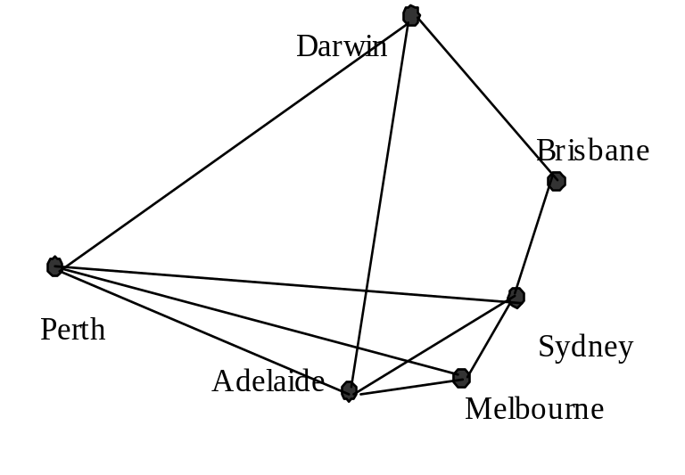
Single-Source Shortest Paths
A motorist wishes to find the shortest possible route from from Perth to Brisbane. Given the map of Australia on which the distance between each pair of cities is marked, how can we determine the shortest route?

Slide 3
Single Source Shortest Path
In a shortest-paths problem, we are given a weighted, directed graph G = (V,E), with weights assigned to each edge in the graph. The weight of the path p = (v0, v1, v2, …, vk) is the sum of the weights of its constituent edges:
v0 → v1 → v2 . . . → vk-1→ vk
The shortest-path from u to v is given by
d(u,v) = min {weight (p) : if there are one or more paths from u to v
= ∞ otherwise

Slide 4
The single-source shortest paths problem
Given G (V,E), find the shortest path from a given vertex
u ∈ V to every vertex v ∈ V ( u ≠v).
For each vertex v ∈ V in the weighted directed graph, d[v] represents the distance from u to v.
Initially, d[v] = 0 when u = v.
d[v] = ∞ if (u,v) is not an edge
d[v] = weight of edge (u,v) if (u,v) exists.
Dijkstra's Algorithm : At every step of the algorithm, we compute,
d[y] = min {d[y], d[x] + w(x,y)}, where x,y ∈ V.
Dijkstra's algorithm is based on the greedy principle because at every step we pick the path of least weight.

Slide 5
Dijkstra's Algorithm : At every step of the algorithm, we compute,
d[y] = min {d[y], d[x] + w(x,y)}, where x,y ∈ V.
Dijkstra's algorithm is based on the greedy principle because at every step we pick the path of least path.

Slide 6
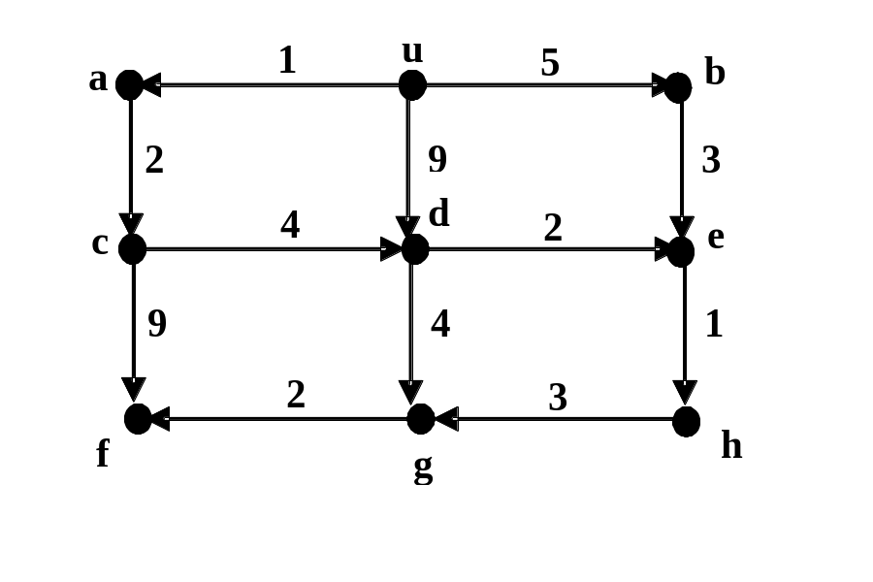

Slide 7
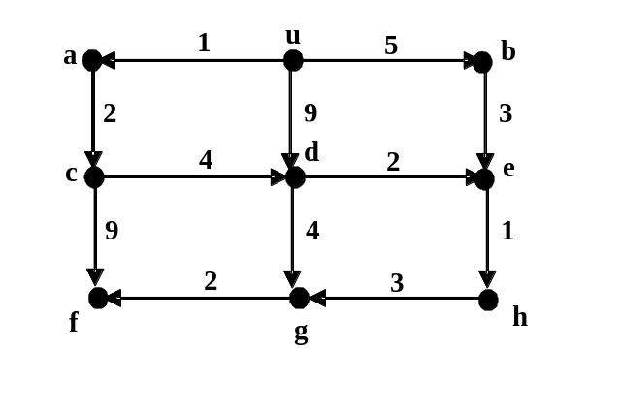
Example:
Step # | Vertex to be marked | Distance to vertex |  |  |  |  |  |  |  |  | Unmarked vertices
 |  | u | a | b | c | d | e | f | g | h
0 | u | 0 | 1 | 5 | ∞ | 9 | ∞ | ∞ | ∞ | ∞ | a,b,c,d,e,f,g,h
1 | a | 0 | 1 | 5 | 3 | 9 | ∞ | ∞ | ∞ | ∞ | b,c,d,e,f,g,h
2 | c | 0 | 1 | 5 | 3 | 7 | ∞ | 12 | ∞ | ∞ | b,d,e,f,g,h
3 | b | 0 | 1 | 5 | 3 | 7 | 8 | 12 | ∞ | ∞ | d,e,f,g,h
4 | d | 0 | 1 | 5 | 3 | 7 | 8 | 12 | 11 | ∞ | e,f,g,h
5 | e | 0 | 1 | 5 | 3 | 7 | 8 | 12 | 11 | 9 | f,g,h
6 | h | 0 | 1 | 5 | 3 | 7 | 8 | 12 | 11 | 9 | g,h
7 | g | 0 | 1 | 5 | 3 | 7 | 8 | 12 | 11 | 9 | h
8 | f | 0 | 1 | 5 | 3 | 7 | 8 | 12 | 11 | 9 | --

Slide 8
Dijkstra's Single-source shortest path
Procedure Dijkstra's Single-source shortest path_G(V,E,u)
Input: G =(V,E), the weighted directed graph and v the source vertex
Output: for each vertex, v, d[v] is the length of the shortest path from u to v.
mark vertex u;
d[u] ← 0;
for each unmarked vertex v ∈ V do
if edge (u,v) exists d [v] ← weight (u,v);
else d[v] ← ∞;
while there exists an unmarked vertex do
let v be an unmarked vertex such that d[v] is minimal;
mark vertex v;
for all edges (v,x) such that x is unmarked do
if d[x] > d[v] + weight[v,x] then
d[x] ← d[v] + weight[v,x]

Slide 9
Complexity of Dijkstra's algorithm:
Steps 1 and 2 take Θ (1) time
Steps 3 to 5 take O(⏐V⏐) time
The vertices are arranged in a heap in order of their paths from u
Updating the length of a path takes O(log V) time.
There are ⏐V⏐ iterations, and at most ⏐E⏐ updates
Therefore the algorithm takes O((⏐E⏐+⏐V⏐) log ⏐V⏐) time.

Slide 10
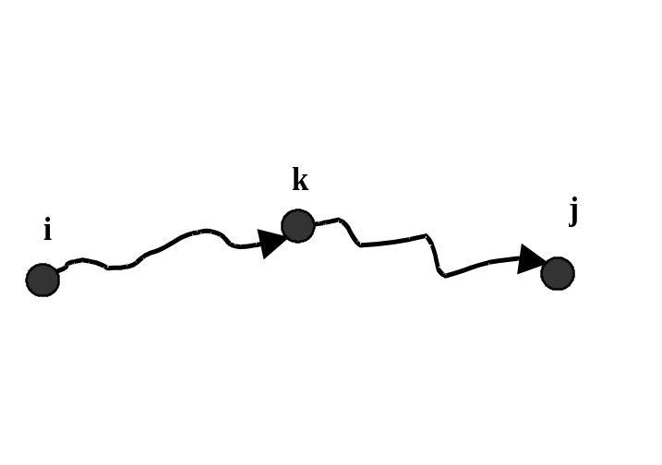
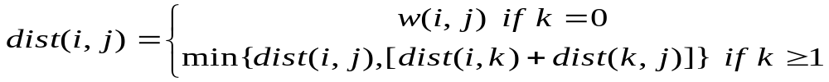
All-Pairs Shortest Path Problem
Consider a shortest path p from vertex i to vertex j
If i =j then there is no path from i to j.
If i ≠ j , then we decompose the path p into two parts,
dist(i,k) and dist(k,j)
dist (i,j) = dist(i,k) + dist(k,j)
Recursive solution

Slide 11
Floyd' s Algorithm for Shortest Paths
Procedure FLOYDs_G=[V,E]
Input: n×n matrix W representing the edge weights of an n-vertex directed graph. That is W =w(i,j) where, (Negative weights are allowed)
Output: shortest path matrix, dist(i,j) is the shortest path between vertices i and j.
for v ← 1 to n do
for w ← 1 to n do
dist[v,w] ←arc[v,w];
for u ← 1 to n do
for v ← 1 to n do
for w ← 1 to n do
if dist[v,u] + dist[u,w] < dist[v,w] then
dist[v,w] ← dist[v,u] + dist[u,w]
Complexity : Θ(n³)

Slide 12
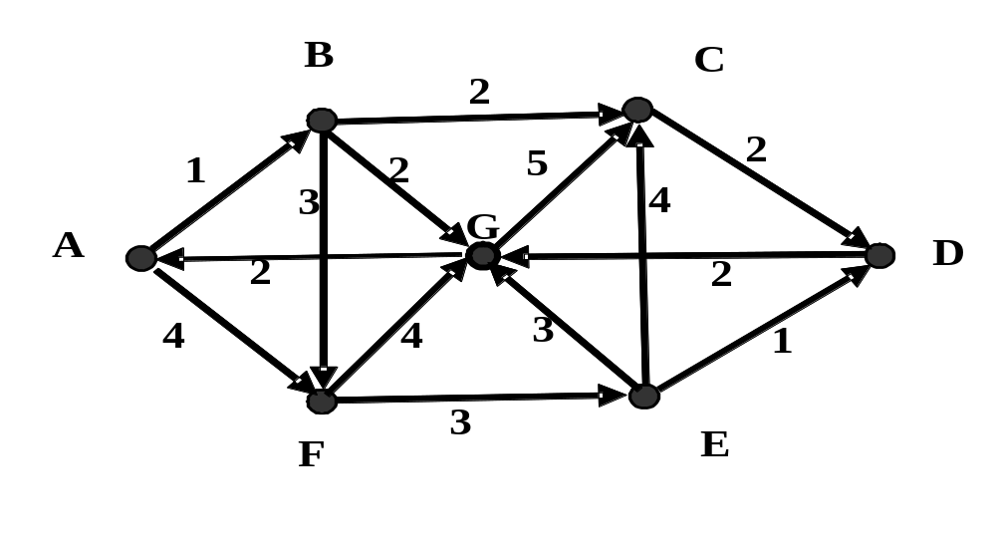

Slide 13
 | A | B | C | D | E | F | G
A | 0 | 1 | ∞ | ∞ | ∞ | 4 | ∞
B | ∞ | 0 | 2 | ∞ | ∞ | 3 | 2
C | ∞ | ∞ | 0 | 2 | ∞ | ∞ | ∞
D | ∞ | ∞ | ∞ | 0 | ∞ | ∞ | 2
E | ∞ | ∞ | 4 | 1 | 0 | ∞ | 3
F | ∞ | ∞ | ∞ | ∞ | 3 | 0 | 4
G | 2 | ∞ | 5 | ∞ | ∞ | ∞ | 0

Slide 14
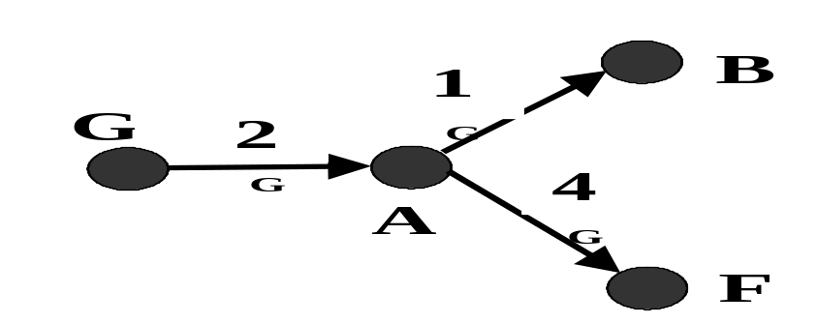
Distances after using A as the pivot
 | A | B | C | D | E | F | G
A | 0 | 1 | ∞ | ∞ | ∞ | 4 | ∞
B | ∞ | 0 | 2 | ∞ | ∞ | 3 | 2
C | ∞ | ∞ | 0 | 2 | ∞ | ∞ | ∞
D | ∞ | ∞ | ∞ | 0 | ∞ | ∞ | 2
E | ∞ | ∞ | 4 | 1 | 0 | ∞ | 3
F | ∞ | ∞ | ∞ | ∞ | 3 | 0 | 4
G | 2 | 3 | 5 | ∞ | ∞ | 6 | 0

Slide 15
 | A | B | C | D | E | F | G
A | 0 | 1 | 3 | ∞ | ∞ | 4 | 3
B | ∞ | 0 | 2 | ∞ | ∞ | 3 | 2
C | ∞ | ∞ | 0 | 2 | ∞ | ∞ | ∞
D | ∞ | ∞ | ∞ | 0 | ∞ | ∞ | 2
E | ∞ | ∞ | 4 | 1 | 0 | ∞ | 3
F | ∞ | ∞ | ∞ | ∞ | 3 | 0 | 4
G | 2 | 3 | 5 | ∞ | ∞ | 6 | 0
Distances after using B as the pivot

Slide 16
 | A | B | C | D | E | F | G
A | 0 | 1 | 3 | 5 | 7 | 4 | 3
B | 4 | 0 | 2 | 4 | 6 | 3 | 2
C | 6 | 7 | 0 | 2 | 13 | 10 | 4
D | 4 | 5 | 7 | 0 | 11 | 8 | 2
E | 5 | 6 | 4 | 1 | 0 | 9 | 3
F | 6 | 7 | 7 | 4 | 3 | 0 | 4
G | 2 | 3 | 5 | 7 | 9 | 6 | 0
Distances after using G as the pivot

Slide 17
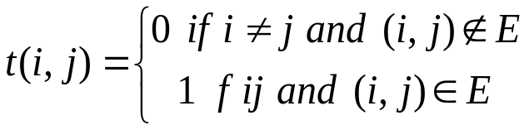
Transitive Closure
Given a directed graph G=(V,E), the transitive closure C =(V,F) of G is a directed graph such that there is an edge (v,w) in C if and only if there is a directed path from v to w in G.
Security Problem: the vertices correspond to the users and the edges correspond to permissions. The transitive closure identifies for each user all other users with permission (either directly or indirectly) to use his or her account. There are many more applications of transitive closure.
The recursive definition for transitive closure is

Slide 18
Warshall's Algorithm for Transitive Closure
Procedure WARSHALL's(G=[V,E])
Input: n×n matrix A representing the edge weights of an n-vertex directed graph. That is a =a(i,j) where,
Output: transitive closure matrix, t(i,j) =1 if there is a path from i to j, 0 otherwise
for v ← 1 to n do
for w ← 1 to n do
t[v,w] ← a(v,w)
for u ← 1 to n do
for v ← 1 to n do
for w ← 1 to n do
if NOT t[v,w] then
t[v,w] ← t[v,u] AND t[u,w]
return T

